Slide 1
Opioid stewardship in acute pain:
Implementing best practice guidelines
DD/MM/YYYY

Slide 2
The intention of this PowerPoint template is to provide an outline for a presentation that introduces the importance of and reasons for commencing an opioid analgesic stewardship program.
It is a guide only and should be adapted to fit the local context and audience.
The slides contain suggestions for initiating conversation & wider discussion are easily modified if desired.
Resources and tools contained in ROSI can be used to support the ideas contained within the presentation.
Additional slides allow for inclusion of local data and prescribing rates have been provided to help ensure relevance and increased engagement of stakeholders.

Slide 3
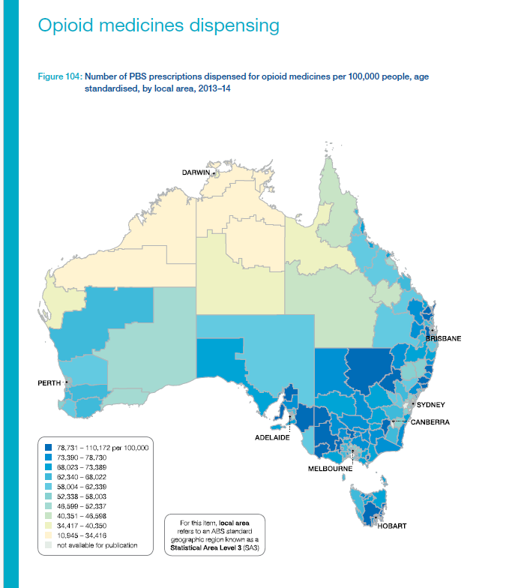
What we know about opioid use in Australia
Opioid medicines are indicated and appropriate for the management of acute pain, cancer pain and in palliative care.
Prescribing rates differ significantly across State/Territories and local postcodes.
They are most likely to be higher if you are located outside a capital city.
Atlas 2015 | Australian Commission on Safety and Quality in Health Care
Opioid medicines dispensing, all ages | Australian Commission on Safety and Quality in Health Care
Image
Figure 1: Number of PBS prescriptions dispensed for opioid medicines per 100,000 people, age standardised, by local area, 2013-14
Source: Australian Commission of Safety and Quality in Health Care. Opioid medicines dispensing. Australian Atlas of Healthcare Variation 2015:262
Notes:
The atlas of healthcare variation includes chapters that examines the rates of opioid medicine dispensing in the community
Rates of opioid use in capital cities is much lower when compared to other areas. As you move further away from each capital city prescribing rates increase. This is common to all states.
Most recent version of the atlas and rates of prescribing 5.7 Opioid medicines dispensing, all ages (safetyandquality.gov.au)

Slide 4
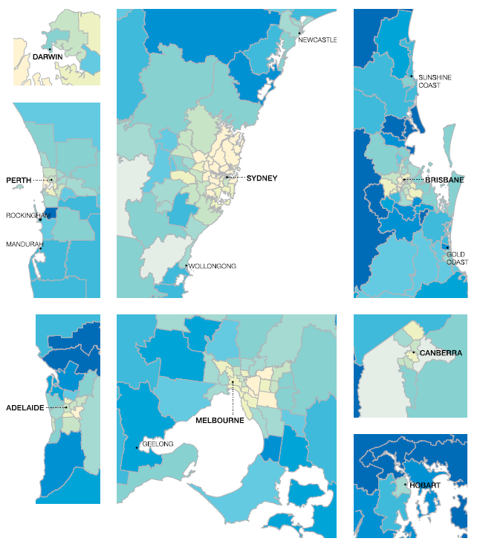
How does our local area compare?
The 2015 Atlas of Healthcare variation found that the number of prescriptions dispensed was 10.1 times higher in the area with the highest rate compared to the area with the lowest rate.
Atlas 2015 | Australian Commission on Safety and Quality in Health Care
Notes:
Presenter Note: When discussing this slide consider your location? Are you in an area known for high rates or prescribing?

Slide 5
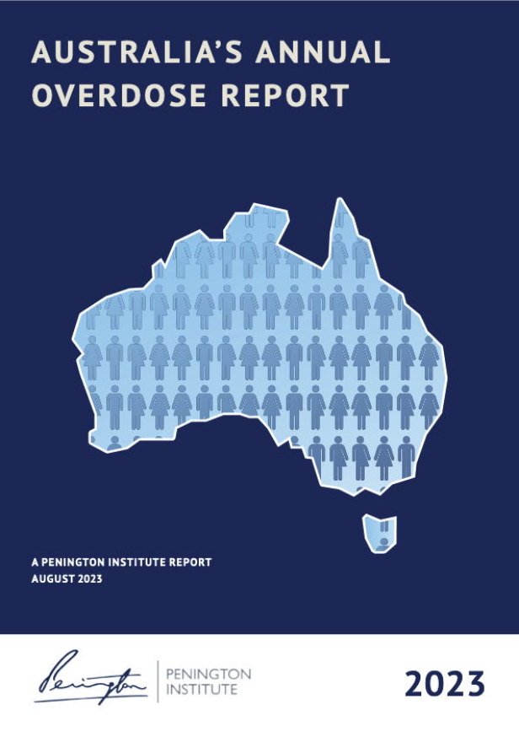
The Penington Report
Australia’s Annual Overdose Report 2023
Opioids were the most common drug type associated with unintentional drug –induced deaths in 2021 contributing to 45.7% of these deaths.
The number of unintentional drug- induced deaths involving opioids almost doubled between 2001-21.
Between 2017-21 there were 195 unintentional drug induced deaths involving pharmaceutical opioids as the sole drug type.
Penington Institute (2023). Australia’s Annual Overdose Report 2023. Melbourne: Penington Institute.

Slide 6
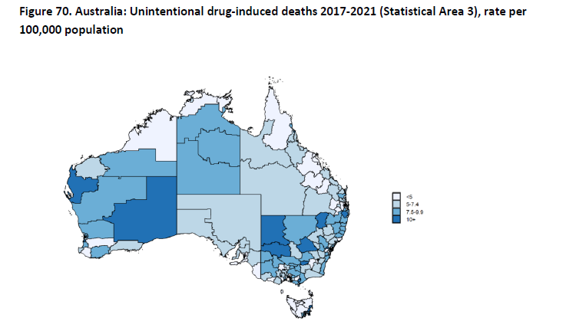
Unintentional drug-induced death maps are almost identical to prescribing rates
Figure 1. Unintentional drug-induced deaths 2017-2021 (Statistical Area 3), rate per 100,000 population
Source: Penington Institute. Australia’s Annual Overdose Report 2023:140
Figure 2. Source: Australian Commission of Safety and Quality in Health Care. Opioid medicines dispensing. Australian Atlas of Healthcare Variation 2015:262

Slide 7
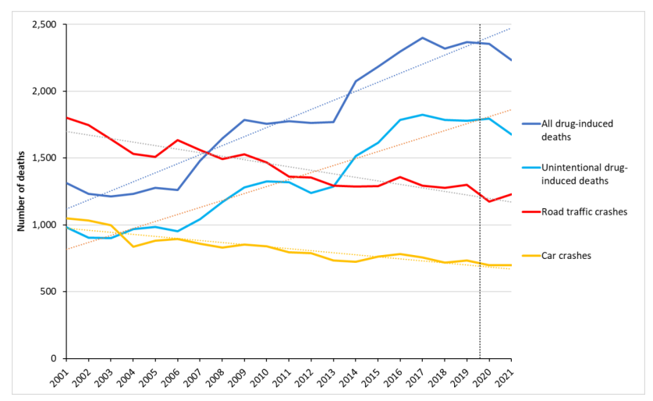
Unintentional drug-induced deaths compared to road fatalities
Figure 1. Number of drug-induced deaths in Australia, compared with road-related deaths, 2001 – 2021 Source: Penington Institute (2023). Australia’s Annual Overdose Report 2023. Melbourne: Penington Institute.
Note: Data to the right of the dotted line (2020 and 2021 data) are preliminary, and likely to rise. ‘Road traffic crashes’ includes all deaths due to road-related accidents; ‘car crashes’ includes only those deaths involving an occupant of a car.
Notes:
There is a great deal of publicity and public messaging about road deaths not so much around unintentional drug-induced death rates

Slide 8
Persistent Post-Operative Opioid Use (PPOU)
Defined as “Continuation of opioids prescribed for postoperative pain for longer than 90 days after surgery” (Levy et al, 2021).
Estimated rates of PPOU may be as high as almost a quarter of some surgical patient groups (Stark et al, 2017).
“Long-term opioid use was reported in over 15% of patients following orthopaedic surgery and appears to be more prevalent in regional locations in Australia” (Liu et al 2023).
In orthopaedic surgical patients, regardless of opioid experience or opioid formulation, the odds of persistence were significantly lower for those who received tapentadol compared with oxycodone (Lam et al 2023).
Levy, N., Quinlan, J., El‐Boghdadly, K., Fawcett, W. J., Agarwal, V., Bastable, R. B., ... & Macintyre, P. E. (2021). An international multidisciplinary consensus statement on the prevention of opioid‐related harm in adult surgical patients. Anaesthesia, 76(4), 520-536.
Stark, N., Kerr, S., & Stevens, J. (2017). Prevalence and predictors of persistent post-surgical opioid use: a prospective observational cohort study. Anaesthesia and intensive care, 45(6), 700-706.
Liu S, Stevens JA, Collins AE, et al. Prevalence and predictors of long-term opioid use following orthopaedic surgery in an Australian setting: A multicentre, prospective cohort study. Anaesthesia and Intensive Care. 2023;51(5):321-330.
Lam, T., Xia, T., Biggs, N., Treloar, M., Cheng, O., Kabu, K., ... & Nielsen, S. (2023). Effect of discharge opioid on persistent postoperative opioid use: a retrospective cohort study comparing tapentadol with oxycodone. Anaesthesia, 78(4), 420-431.
Notes:
No explanation is required as to the risk associated with long term use of opioid analgesics
Initiation of a MR opioid is recognised as one of the most significant risk factors for PPO.

Slide 9
Opioid analgesic stewardship

Slide 10
Opioid analgesic stewardship involves supervising or taking care of opioid analgesics and applies a systematic approach to optimising the use of opioid analgesics. This extends to appropriate and safe use of opioid analgesics, with effective monitoring and surveillance (ACHS).
Specifically, the goals are to ensure the rational use of opioids: meeting the needs of individuals who require pain control, while minimising harms to the individual and to other persons and populations. These harms include those that may arise from opioid overuse, misuse and diversion (ANZCA FPM).
Shrestha S, Khatiwada AP, Sapkota B, Sapkota S, Poudel P, Kc B, Teoh SL, Blebil AQ, Paudyal V. What is "Opioid Stewardship"? An Overview of Current Definitions and Proposal for a Universally Acceptable Definition. J Pain Res. 2023 Feb 10;16:383-394. doi: 10.2147/JPR.S389358. PMID: 36798077; PMCID: PMC9926985.

Slide 11
Opioid Stewardship ≠ Opioid Phobic
Analgesic stewardship does not advocate the withholding of opioids for acute pain when appropriate.
It does ensure that the appropriate formulation and dose is prescribed with clear plans for duration, weaning and ceasing.
Information on prescribing is shared with the patient, family or carer and General Practitioner.

Slide 12
Who, What and Why
  Opioid Analgesic Stewardship is a shared responsibility (ACHS 2022)
  Any member of the multidisciplinary team can act as an opioid stewardship champion, action change and promote safe practice. It does not require large teams.
  Opioid Stewardship does require engagement of all stakeholders & this can be challenging.
  However,
  In order to ensure patient safety and best practice; analgesic management and opioid prescribing must align with evidence based published recommendations hence opioid stewardship programs are essential.

Slide 13
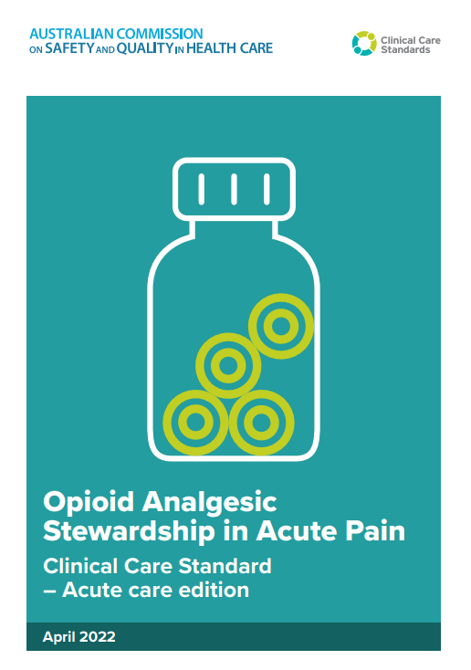
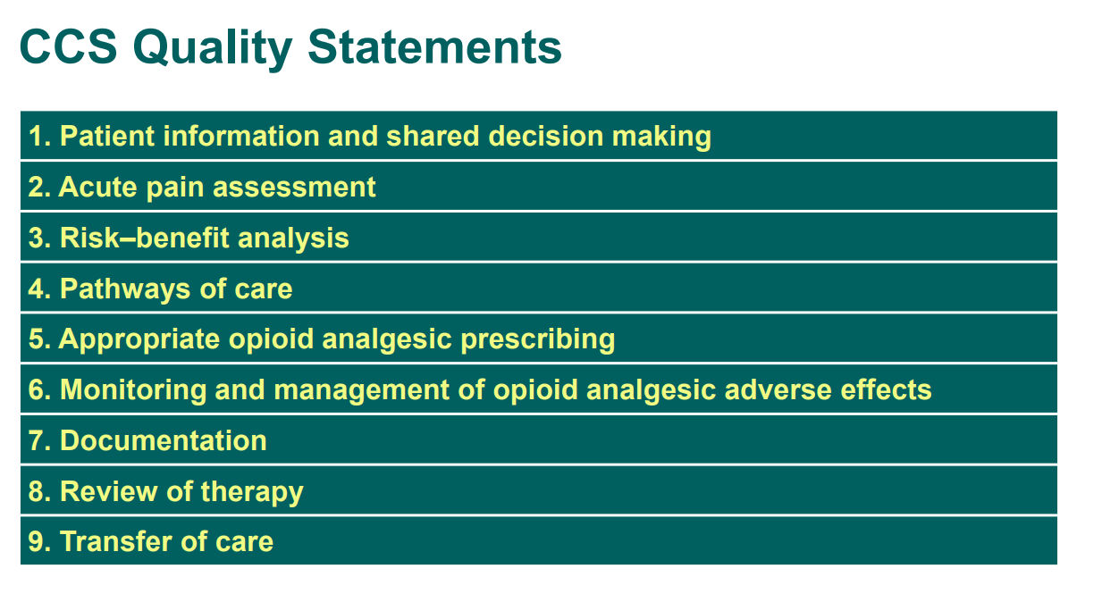
Australian Commission on Safety and Quality in Health Care
Opioid Stewardship in Acute Pain Clinical Care Standard- Acute Care edition 2022
Notes:
Recommendations from peak professional bodies outline the why and how of opioid stewardship

Slide 14
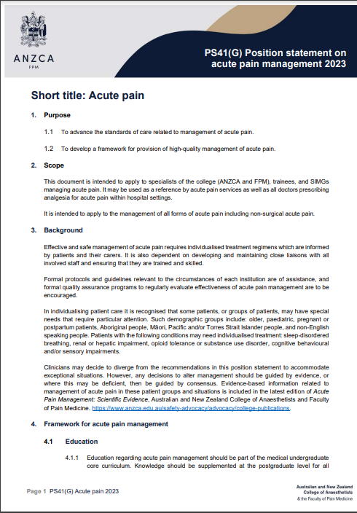
4.3.5 Analgesic Stewardship programs are recommended.
4.3.6 Implementation of established guidelines and order sets are recommended.
7.1 Modified Release opioid formulations are not recommended for the management of acute pain their use should be exceptional rather than routine use has been demonstrated to:-
  Provide less effective pain relief.
  Increase the risk of OIVI and other opioid-related adverse events.
  Increase the risk of PPOU.
Australian and New Zealand College of Anaesthetists and Faculty of Pain Medicine. Position statement on acute pain 2023. From https://www.anzca.edu.au/getattachment/558316c5-ea93-457c-b51f-d57556b0ffa7/PS41-Guideline-on-acute-pain-management
Accessed January 2024.
Notes:
“Slow-release opioids are not recommended for use in the management of patients with acute pain”.
The planning of weaning and ceasing the opioid remains the responsibility of the person who initiated it.”
Significant risk of respiratory depression, resulting in severe adverse events and death.”

Slide 15
What makes a good opioid stewardship program?

Slide 16
Essential components
Patient engagement
Use of prescribing guidelines
Count pills - examine the dispensing rates
Measure outcomes and safety - hospital acquired complications (HACs)
Notes:
Its not as hard as you think but theses are essential

Slide 17
Patient Engagement
  Change the language you use with patients.
  Make sure patients understand their expected pain trajectory and recovery course.
  Discuss the role of the medication as an aid to functional improvement and not an absence of pain.
  Use functional pain assessments to guide prescribing.
  Engage patients in the discussion about the need for ongoing analgesics and expectations for the duration of opioid medication. These discussions should
  occur in the preoperative clinic and again when opioids are initially prescribed.

Slide 18
Prescribing
  Do not prescribe modified-release / slow-release preparations.
  Preference the prescribing of atypical opioids.
  Prescribe a single opioid.
  Ensure the opioid dose is appropriate given patients age and other co-morbidities.
  Use protocols that provide prescribing support.
  Maximise non opioid analgesic prescribing.
  Time limit or have a plan for weaning.

Slide 19
Prescribing
Insert any local guidelines/links /images here
OR
Use the ROSI guide to obtain resources that can be adapted to local context
Notes:
Consider what your current protocols are – do they need to be revised.

Slide 20
What's wrong with 1-2 days of MR?
Multiple international bodies recommend against this practice
  The Australian and New Zealand College of Anaesthetists and its Faculty of Pain Medicine
  UK Royal College of Anaesthetists and its Faculty of Pain Medicine
  United States Centers for Disease Control and Prevention
  American Pain Society
  MR opioids should not be initiated within the first 1-2 weeks of onset of acute pain.
  MR opioids have an increased risk of adverse events in particular increased sedation score and OIVI.
  MR opioids do not improve pain scores or functional ability.
  Initiation of an MR formulations is one of the main risk factors for PPOU.

Slide 21
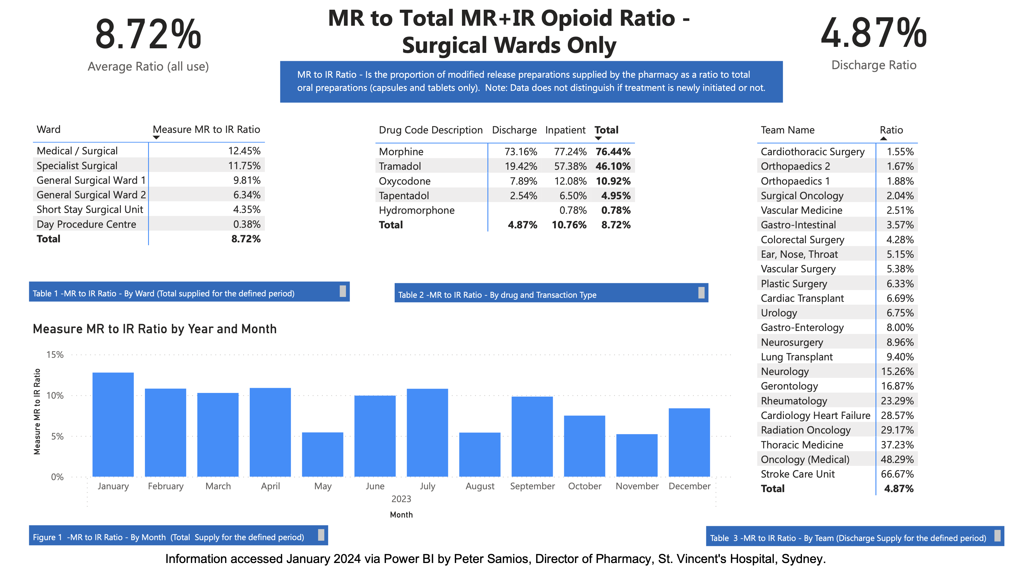
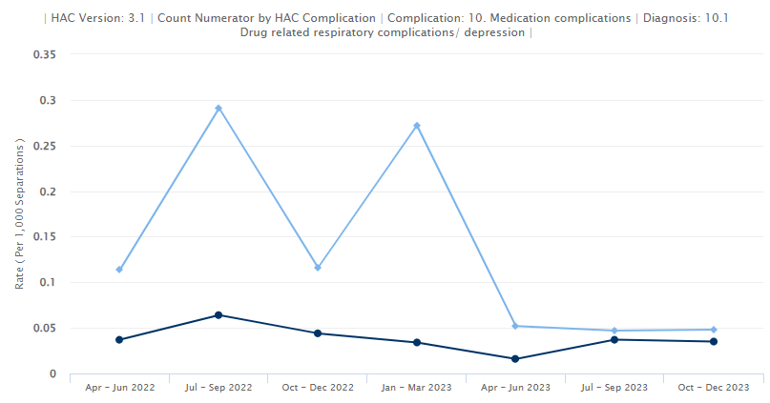
Collect Data and Audit

Slide 22
Translating evidence into practice
What does our facility need to change?
Notes:
Discuss what the focus for your local facility needs to be .
Consider what might be your first step? Lanyard , changing MR prescribing habits, rollout of the discharge form?

Slide 23
Local Prescribing Habits
Insert local data and graphs here
Use the ROSI guide to assist with data collection
Image

Slide 24
Hospital acquired complication (HAC) rates
Image
Insert local data and graphs here
Use the ROSI guide to assist with data collection

Slide 25
Use this slide to include any other information particular to your facility that may assist with engagement of stakeholders

Slide 26

References:
Atlas 2015 - 5. Opioid medicines | Australian Commission on Safety and Quality in Health Care
Opioid medicines dispensing, all ages | Australian Commission on Safety and Quality in Health Care
Penington Institute (2023). Australia’s Annual Overdose Report 2023. Melbourne: Penington Institute.
Levy, N., Quinlan, J., El‐Boghdadly, K., Fawcett, W. J., Agarwal, V., Bastable, R. B., ... & Macintyre, P. E. (2021). An international multidisciplinary consensus statement on the prevention of opioid‐related harm in adult surgical patients. Anaesthesia, 76(4), 520-536.
Stark, N., Kerr, S., & Stevens, J. (2017). Prevalence and predictors of persistent post-surgical opioid use: a prospective observational cohort study. Anaesthesia and intensive care, 45(6), 700-706.
Liu S, Stevens JA, Collins AE, et al. Prevalence and predictors of long-term opioid use following orthopaedic surgery in an Australian setting: A multicentre, prospective cohort study. Anaesthesia and Intensive Care. 2023;51(5):321-330. doi:10.1177/0310057X231172790
Lam, T., Xia, T., Biggs, N., Treloar, M., Cheng, O., Kabu, K., ... & Nielsen, S. (2023). Effect of discharge opioid on persistent postoperative opioid use: a retrospective cohort study comparing tapentadol with oxycodone. Anaesthesia, 78(4), 420-431.
Shrestha S, Khatiwada AP, Sapkota B, Sapkota S, Poudel P, Kc B, Teoh SL, Blebil AQ, Paudyal V. What is "Opioid Stewardship"? An Overview of Current Definitions and Proposal for a Universally Acceptable Definition. J Pain Res. 2023 Feb 10;16:383-394. doi: 10.2147/JPR.S389358. PMID: 36798077; PMCID: PMC9926985.
Australian Commission on Safety and Quality in Healthcare. Opioid Analgesic Stewardship in Acute Pain Clinical Care Standard- Acute Care edition. ACSQHC (2022) retrieved from https://www.safetyandquality.gov.au/publications-and-resources/resource-library/presentation-slides-launch-opioid-analgesic-stewardship-acute-pain-clinical-care-standard accessed January 2024
PS41(G) Position statement on acute pain management Background paper Short title: Acute Pain BP FPM 2023a
Miller M, Barber CW, Leatherman S, et al. Prescription Opioid Duration of Action and the Risk of Unintentional Overdose Among Patients Receiving Opioid Therapy. JAMA Intern Med. 2015;175(4):608–615. doi:10.1001/jamainternmed.2014.8071
Gohler K, Brett M. Comparative pharmacokinetics and bioavailability of Tapentadol following oral administration of immediate- and prolonged-release formulations. Medicine International Journal of Clinical Pharmacology and Therapeutics. 2013; 51:338-4z
The Resources for Opioid Stewardship Implementation (ROSI) have been developed by Ms. Bernadette Findlay, Clinical Nurse Consultant, and Associate Professor Jennifer Stevens, Anaesthetist and Pain Medicine Specialist at St. Vincent’s Hospital, Sydney, in conjunction with the Faculty of Pain Medicine. Development of the ROSI has been supported by an unrestricted educational grant from CSL Seqirus. CSL Seqirus were not involved in the creation of intellectual property or any other content contained within the ROSI.

